Slide 1

Planote
The Universal Organisation App

Slide 2
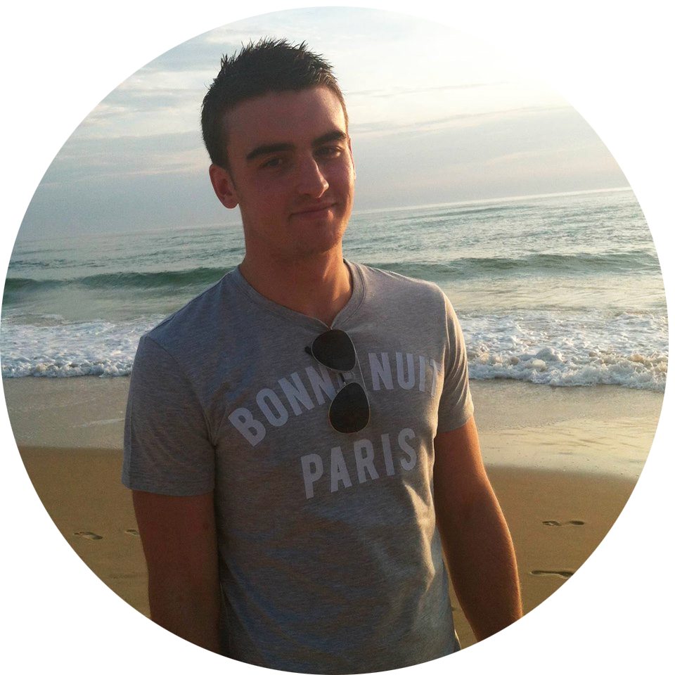
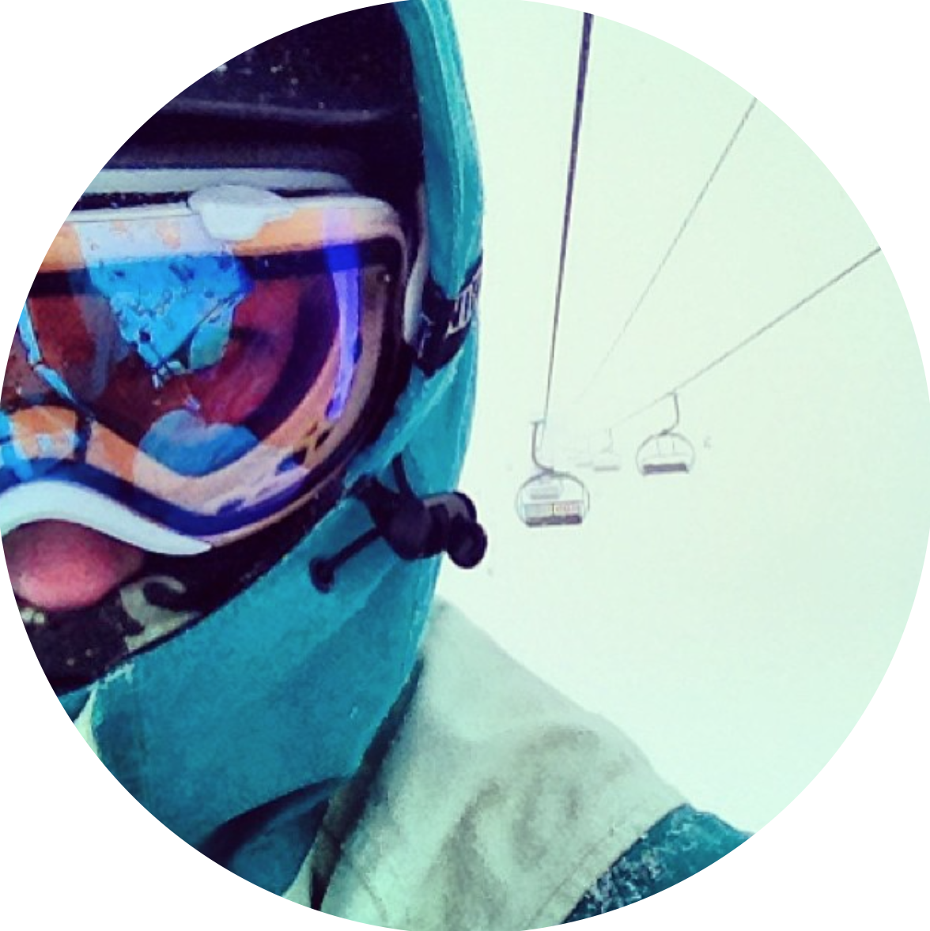
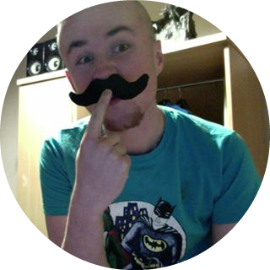
Planote Team
Peter Bohane
Marketing & Sales
Brie Lloyd-Evans
Design
Robert Gabriel
Technology & Finance
Excepteur sint occaecat cupidatat non proident, sunt in culpa qui officia deserunt mollit anim id est laborum

Slide 3

“If You Aren't Taking Notes, You Aren't Learning”
Daniel Roth, Executive Editor at LinkedIn,
Notes:
Mark in the town hall, talking about how he wouldnt become the person he was if it wasn't for taking notes.

Slide 4
The Problem
Confusion
Access on multiple devices
Losing notes
Notes:
Brie - not knowing your timetable and correct times, accessing several machines in one day. Forgeting USBs. Lack of organisation in regards to notes.

Slide 5
The Solution
Class alerts
Timetable
Cross syncing
Note organisation
Virtual assistant
Notes:
Brie - preventing poor time management, ability to search and store notes all in the one location, keeping organisation to a maximum. Other competitors were lacking the same types of features - easy to navigate layout

Slide 6
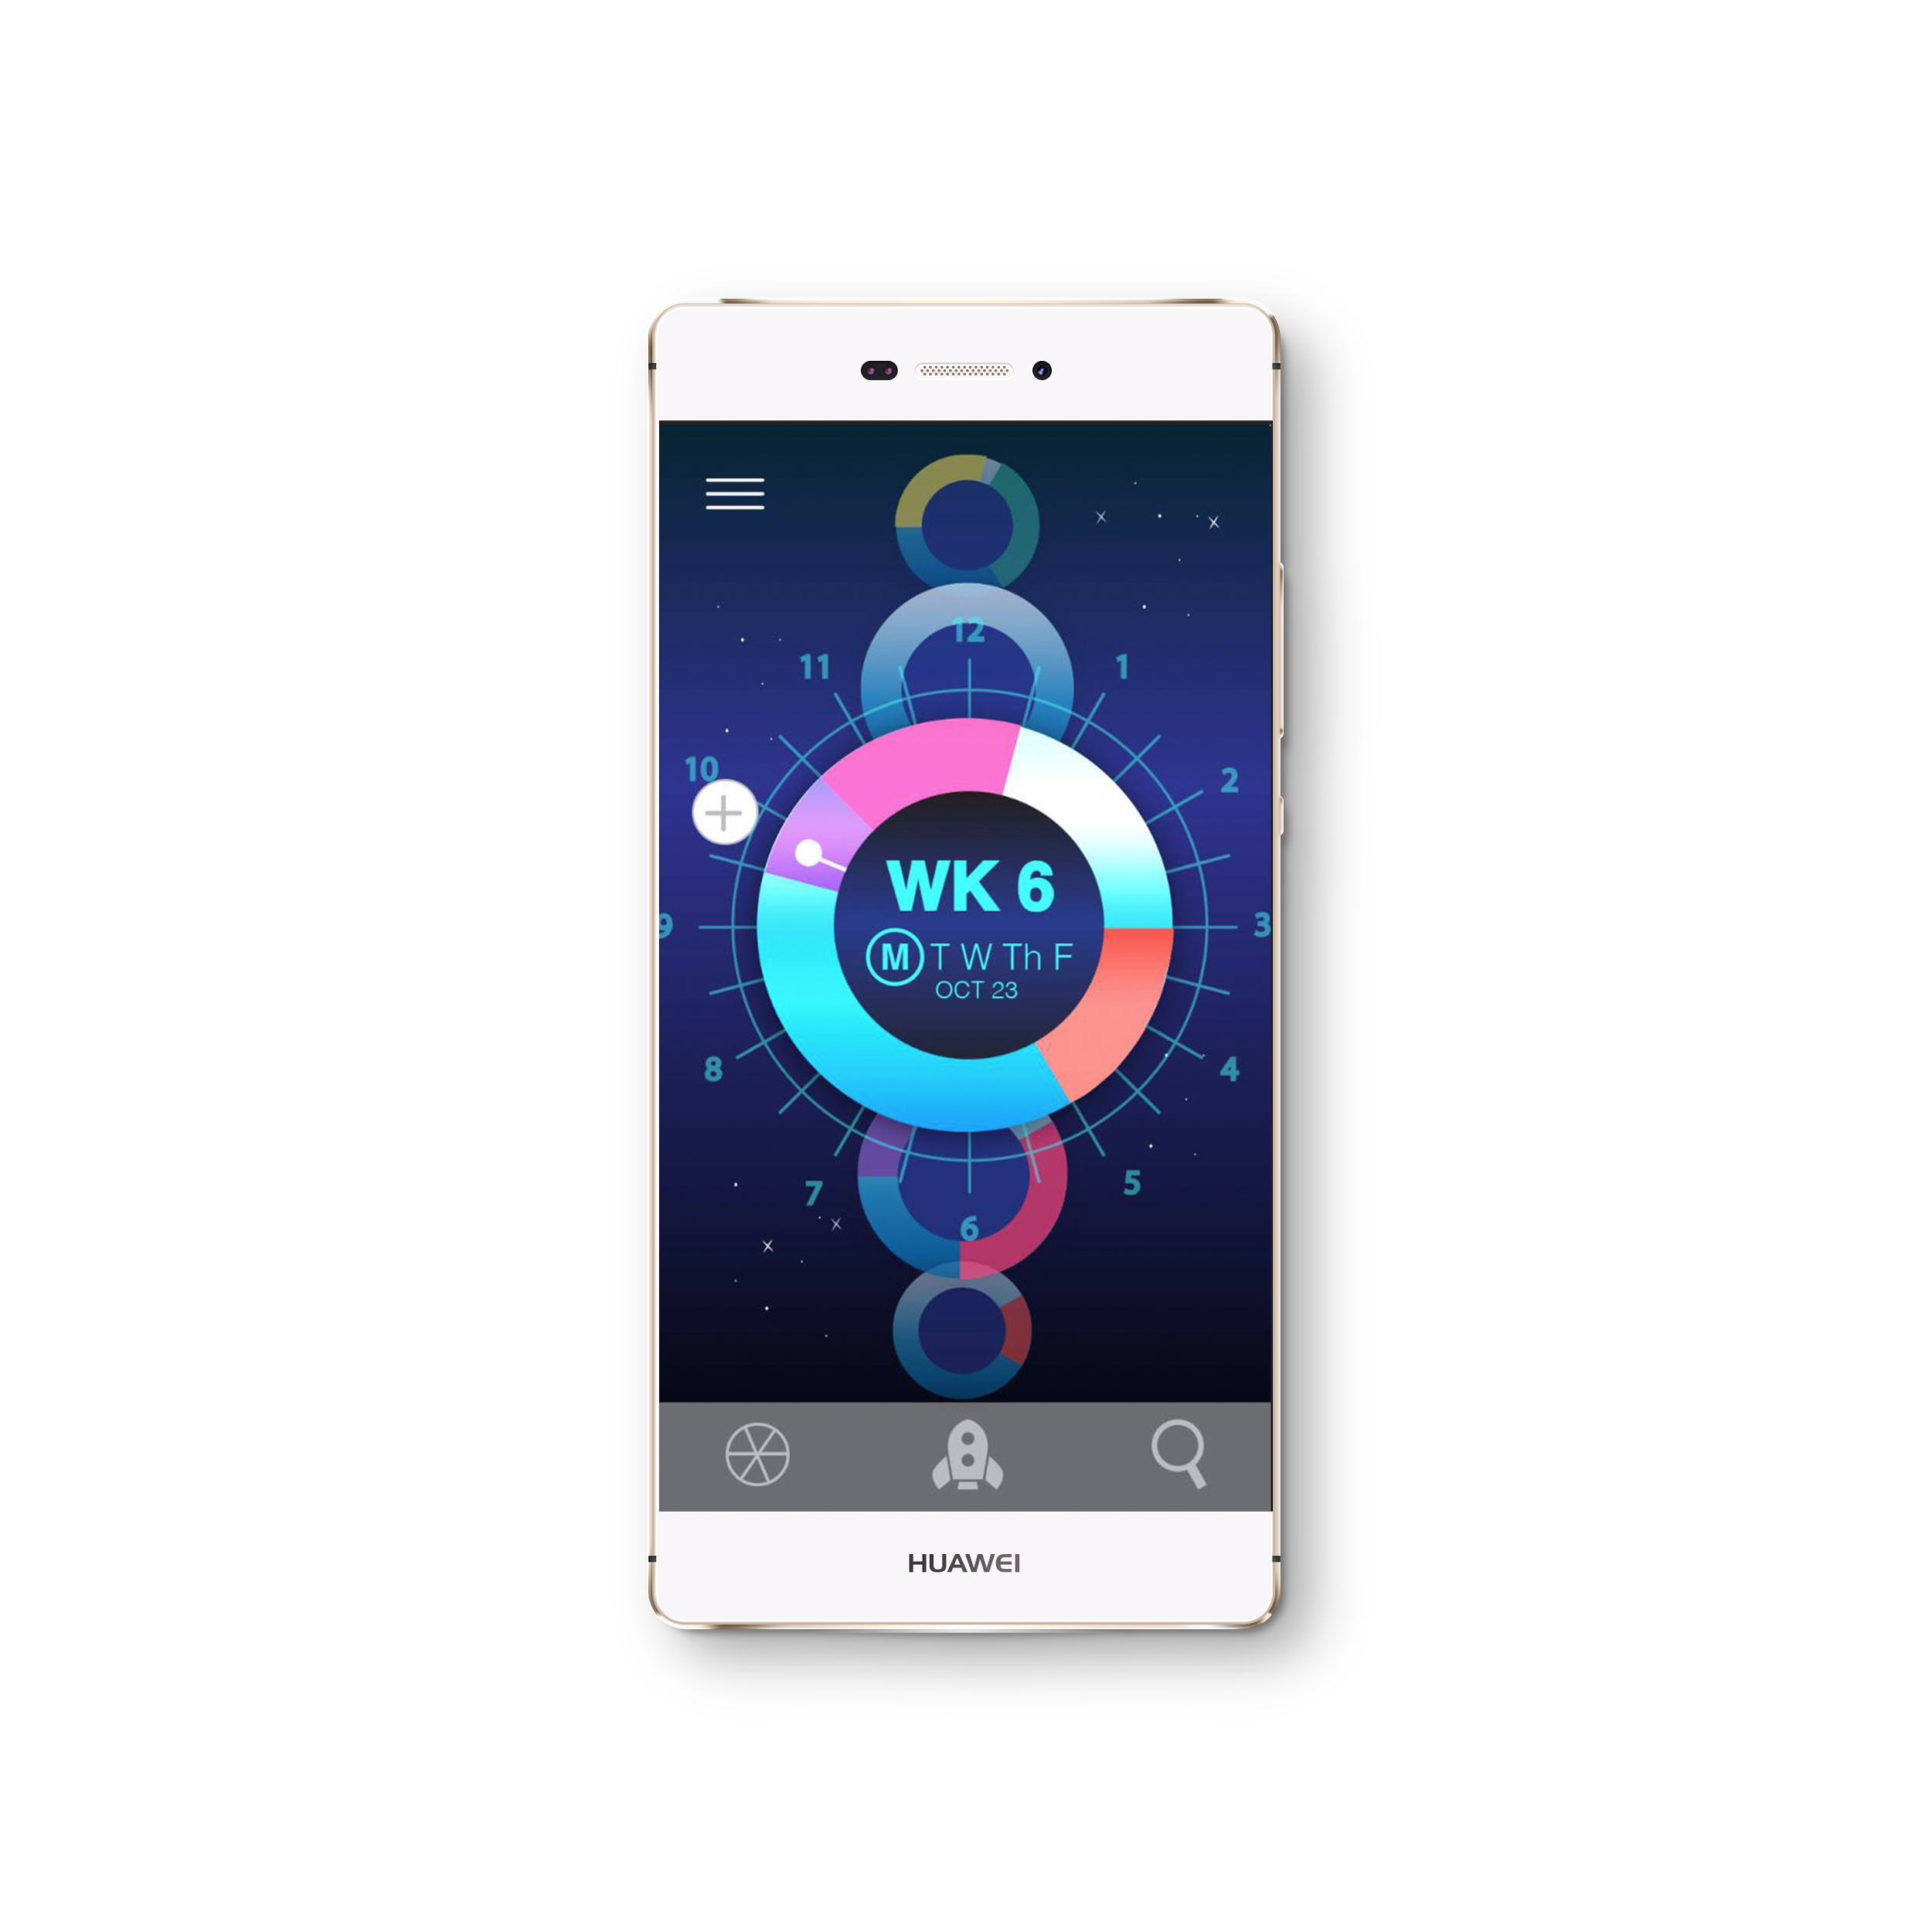
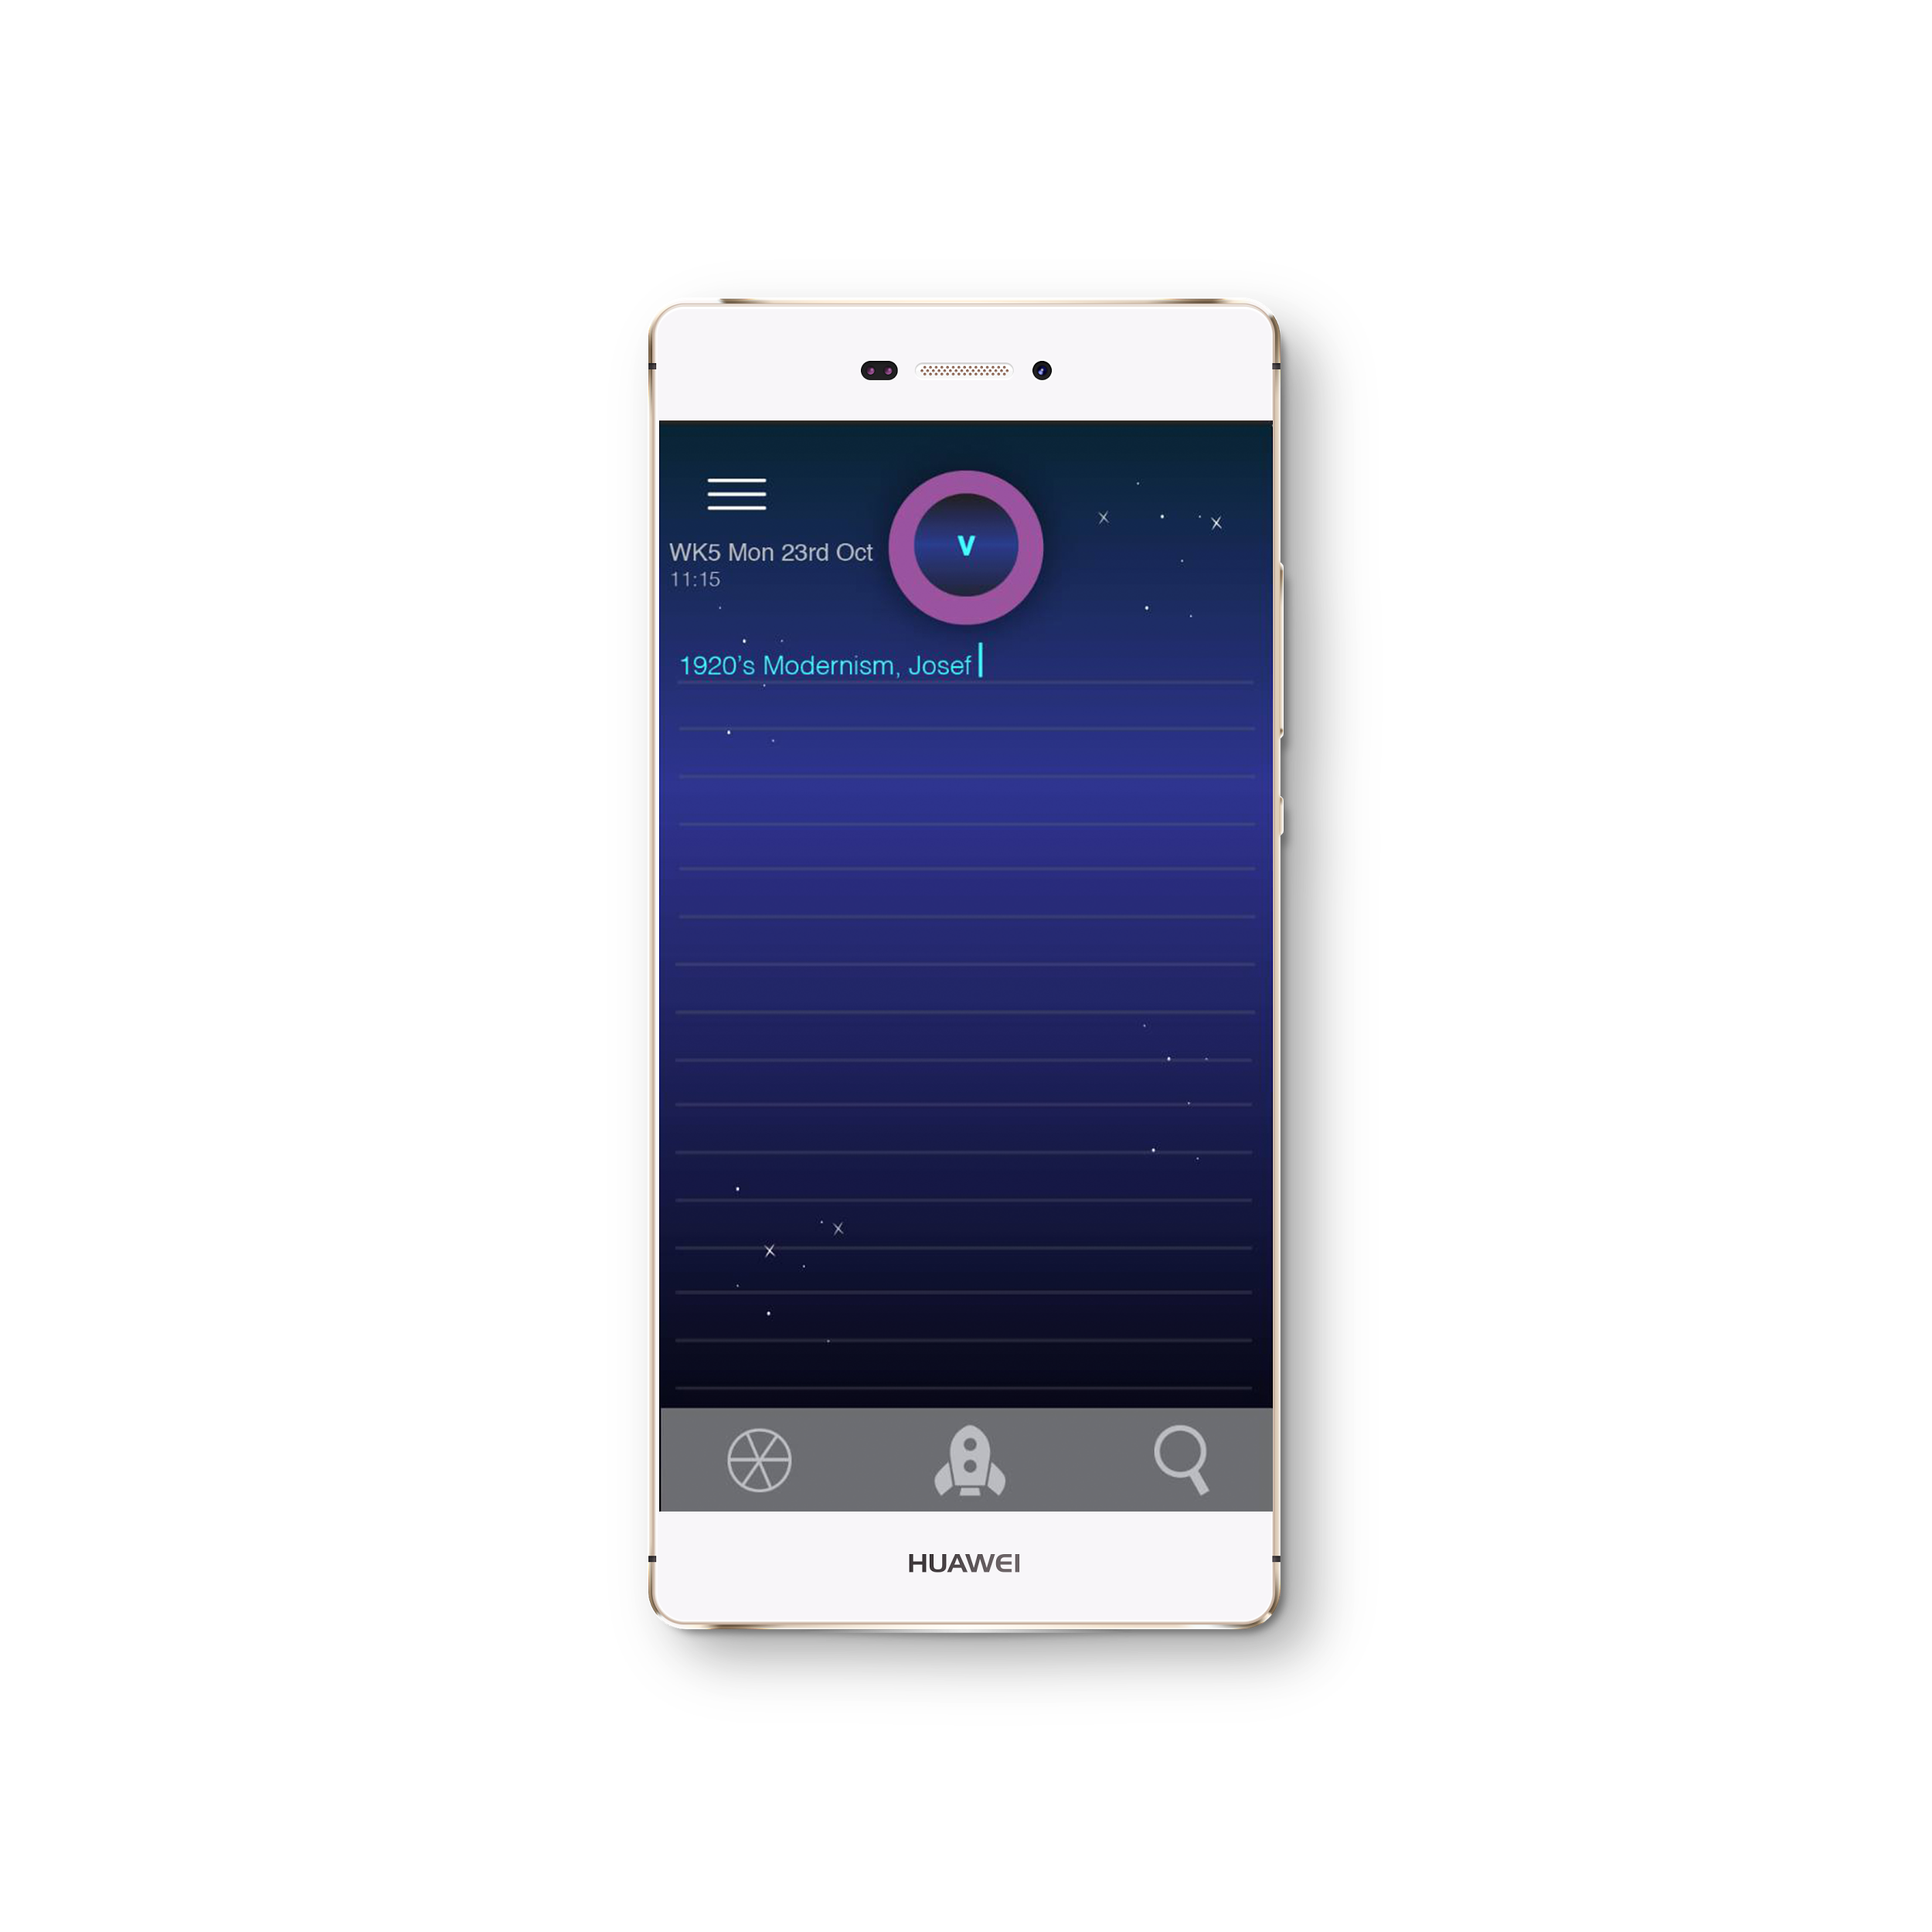
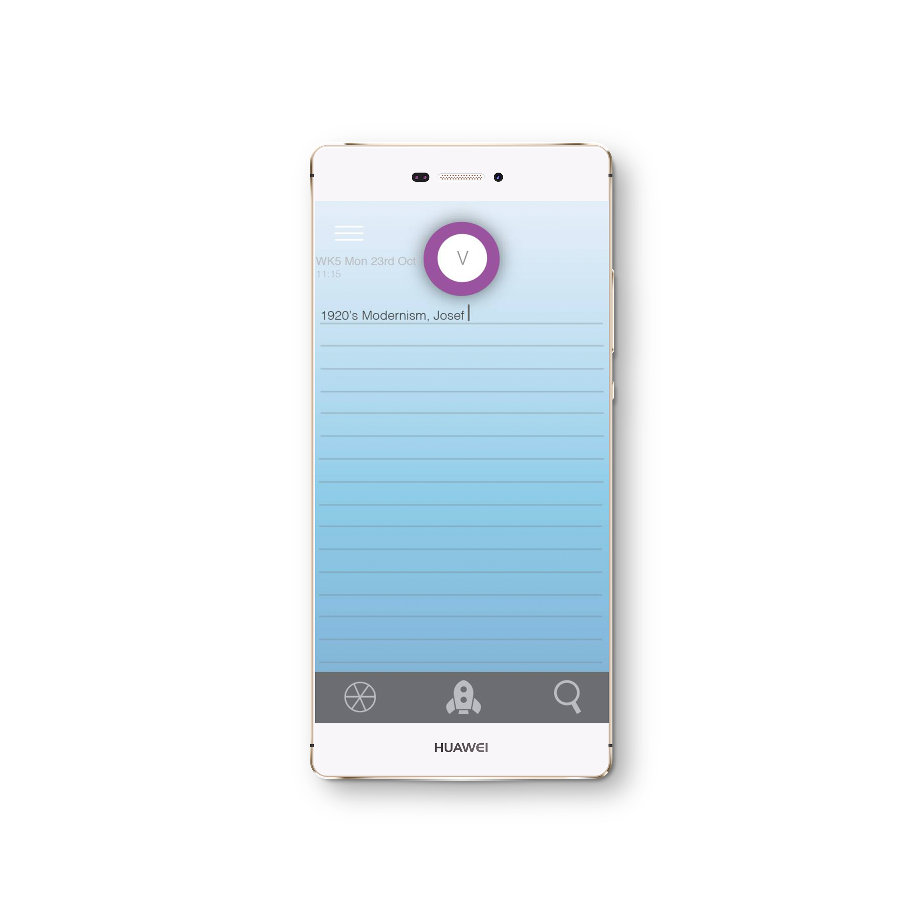

Notes:
light planetary theme, refering to the orbiting of icons across the screen. Familiar clock face and dial to assist navigation through daily timetable

Slide 7
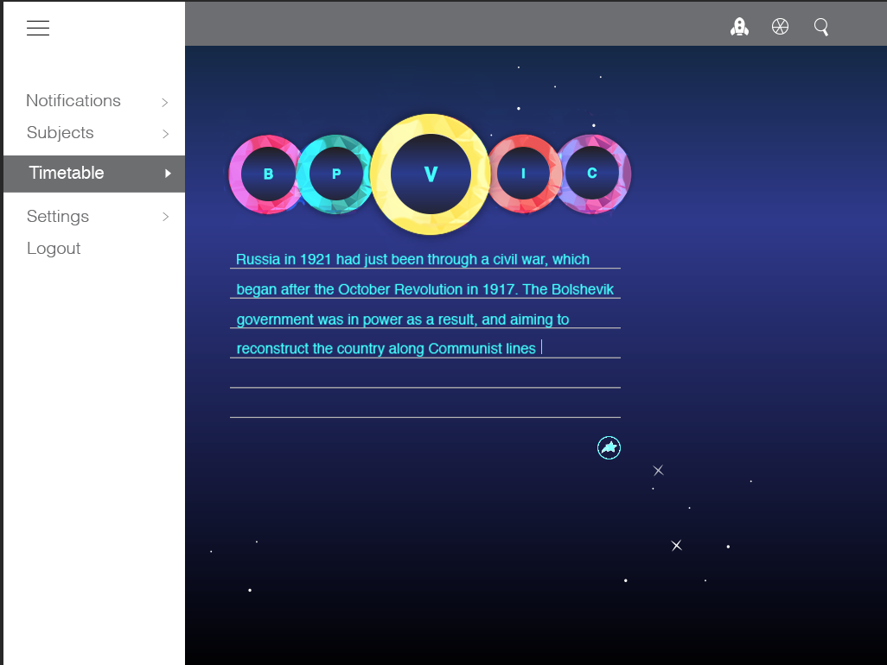
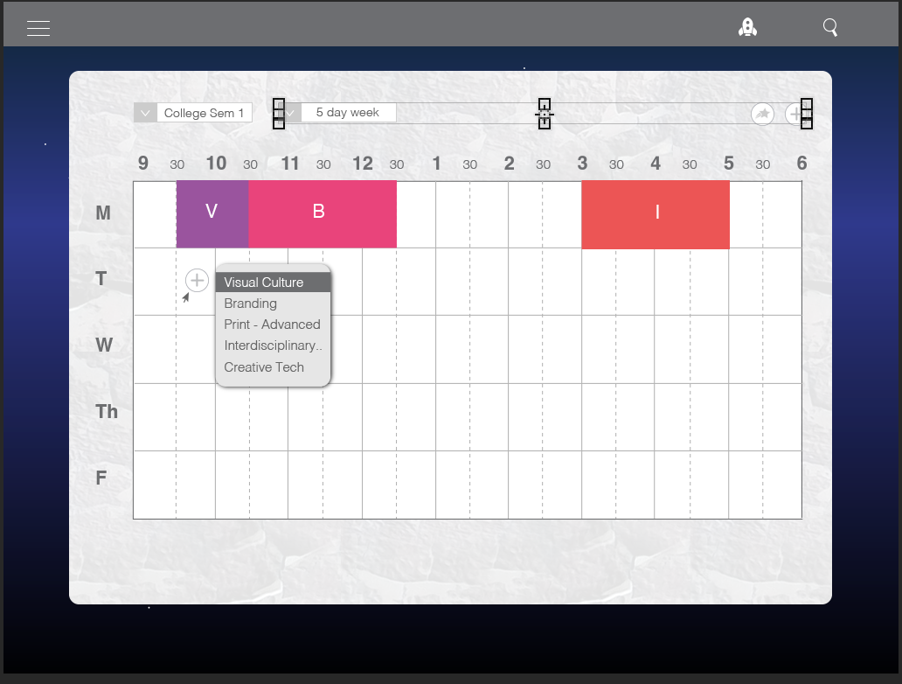
Notes:
light planetary theme, refering to the orbiting of icons across the screen. Familiar clock face and dial to assist navigation through daily timetable

Slide 8
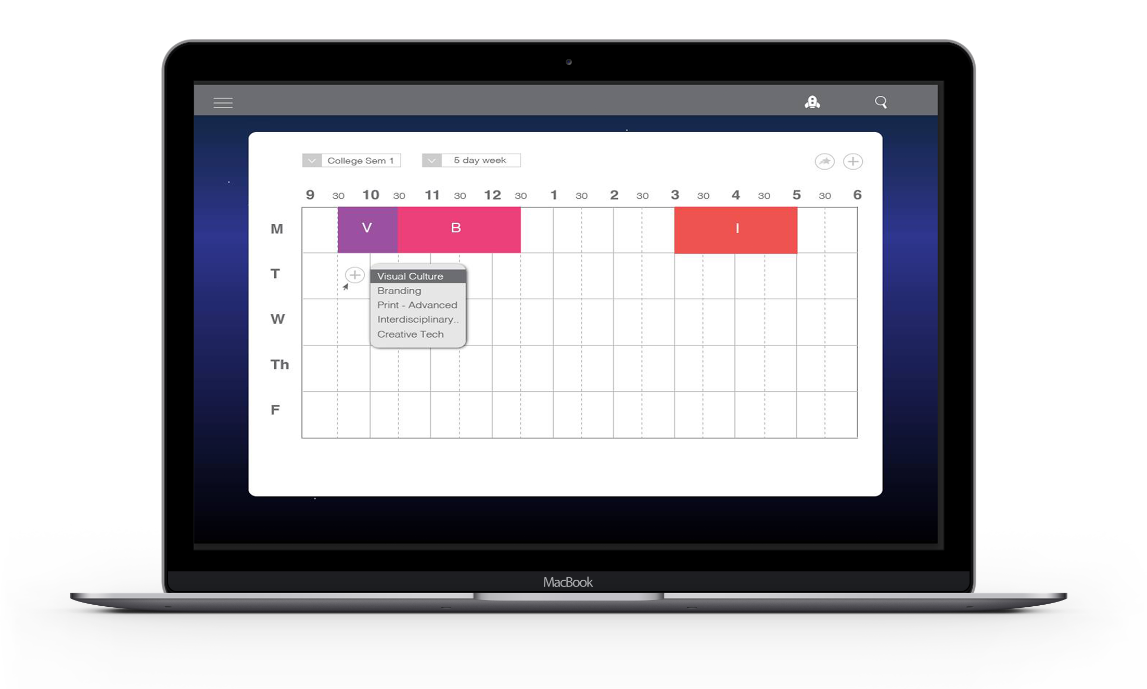
Features
Cloud storage.
Cross Syncing
Multiple timetables.
Share timetables & notes.
Grade and Attendance tracking.
Notifications.
Intuitive interface.
Personalization.
Integrations
Widgets
Notes:
Brie - creating themes to suit the user, allows you to access across different devices. To suit busy lifestyles can be used for work and hobbies etc.

Slide 9

The Technology
Cross Syncing with Innovative Design

Slide 10
Target Market
21M
Third Level Students
16-24
Ireland
UK & US
24.2 Million
US
3.03M
174,000
UK
IE
Notes:
Peter - Our main target market is third-level students, aged between 16-24. We will initially release our app in ireland, and we have plans to release our app in the UK & US in August 2016. This will give us access to a target market of 24.2 Million Students.

Slide 11


Google Play Store
Apple App Store
150b Downloads
100,000 Average Downloads
800 million android users
70% Revenue for Developer
€25 Developer Fee
100b Downloads
62,500 average downloads
500 Million iPhone users
70% Revenue for Developer
€99 Developer Fee
Notes:
Peter - Our Channel of Distribution will be through the Google and Apple App Stores. the google play store to date has had over 150 billion downloads, averaging at 100,000 downloads per app. The Apple App store has had over 100 billion doenloads, with an average of 62,500 downloads per app. Google and Apple will take 30% of the revenue from all sales, but it is very cheap to publish your app on the app stores. (25€ on Google and €99 on Apple.). These App Stores have 100m combined daily users.

Slide 12
Revenue model
Free Download
Subscription(€1.99/M)
Promotional Price
Note organization
One timetable
Task management
Grade tracking
Attendance tracking
Notifications
Pro features
Increased Storage
Share Notes & Timetables
Widgets
Integrations
Personalization
Referral Discount - Next Payment 50% off.
Year Subscription - €13.99 (40% Discount)
Notes:
Peter - Our revenue will be based on a freemium-subscription model. The App will be free to download, and premium features can be unlocked by paying a monthly subscription of €1.99. This will give users access to Increased storage, sharing, widgets and personalization options. To entice people into further purchases, we have promotional prices. Referring a friend gives you a 50% discount on your next purchase, and you can purchase a year’s subscription with savings of 40%.

Slide 13
The Competition
300K
Evernote
Class Timetable
TimeTable++
Simple Design
Popular App
No Notes
No Cloud Support
No grade tracking
No sharing
Nice Features
Grade tracking
Clunky Interface
Can’t Remove Ads
Notes cannot be shared
No Cloud Support
Dominant note taking app
Cloud Support
Difficult Interface
No Timetable
No note sharing
€5 / Month
51K
20K
Downloads / Month
Notes:
Peter - Our main competitors are apps such as evernote, class timetable and Timetable plus. Evernote is the dominant note taking app on the market with 300,000 monthly downloads. it has cloud storage, supports multiple platforms and good provides good organisation, however it has a very difficult interface,no timetable, no note sharing and it costs 5€ per month. Class timetable is a basic timetable app with approximately 52,000 downloads per month, but has no cloud or note taking support, while TimeTable++ has nice features but a clunky interface, made worse by the fact that you cannot remove the ads. It also has no cloud support.

Slide 14
Sales Projections
Exams
February 1st - December 31st
Total Sales € 26,950
After Tax € 16224
College
Resumes
9000
7000
UK & US Launch
Exams
5000
3000
Summer
Launch
700
700
700
350
300
150
50
Notes:
Peter. Here are our sales projections for our first year of trading. We expect to see sales spikes at significant points in the year, such as the beginning of the college year and exam times. We expect sales to increase more rapidly after we break into the UK & US markets. We project to have sales of 26,950. After fees and taxes we will have sales of 14,526.

Slide 15
Financial Projections
Costs | €
Capital | 3,400
Fixed | 19,000
Variable | 700
Total | 23,100
Balance | €
Funding | 35,000
Sales | 16,224
Costs | (23,100)
Total | 26,426
Notes:
Peter - Our total costs will be 23,100, and taking funding into account, we project to have a surplus of 26,426 at the end of year 1.

Slide 16
Milestones
February 2016
Release a beta of the Timetable and Notes app to the Irish Google Play Store
December 2016
Expand app features to cater for businesses and sports teams.
July 2018
have up to 10 employees and have ongoing plans to release a new App.
August 2016
Release App in UK & US.
July 2017
Release Planote in
Inernational App Stores.
Notes:
Peter - In the future, we plan to release our app in the UK & US app stores, before releasing our app to international app stores in July 2017. by July 2018 we hope to have 10 employees and plans to release a new app.

Slide 17
Thank You for Listening
Interdisciplinary Group 3

